Slide 1
F I T C O I N
Notes:
YouTube Link: https://youtu.be/F0loYK7LzyA

Slide 2
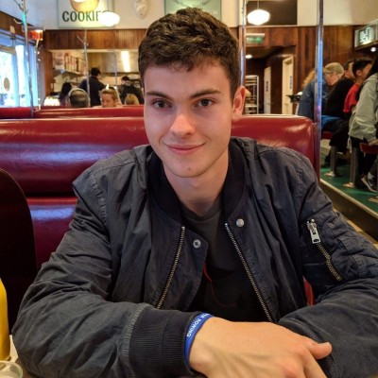
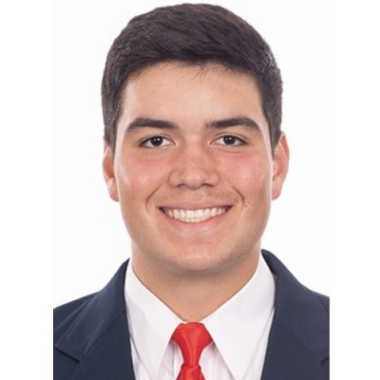
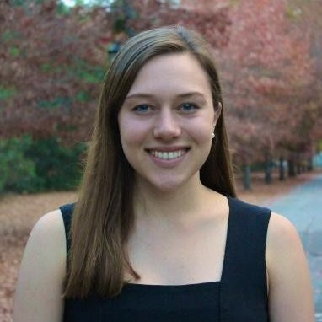
Team
Nick M.
Dylan P.
Caroline F.

Slide 3
Fun fitness for all
Fitcoin Value Proposition

Slide 4
Problem
Solution
People can’t sustain their healthy exercise habits.
People are not motivated by numeric goals, but instead by meaningful goals achievable for them.
They want to be distracted from the effort by having fun, either through achievements, social interactions or competitions.
We gamify exercise to make fitness approachable and sustainable for all people.
We provide them with:
Personalized goals
Demographically-similar community
Checking in qualitatively and infrequently

Slide 5
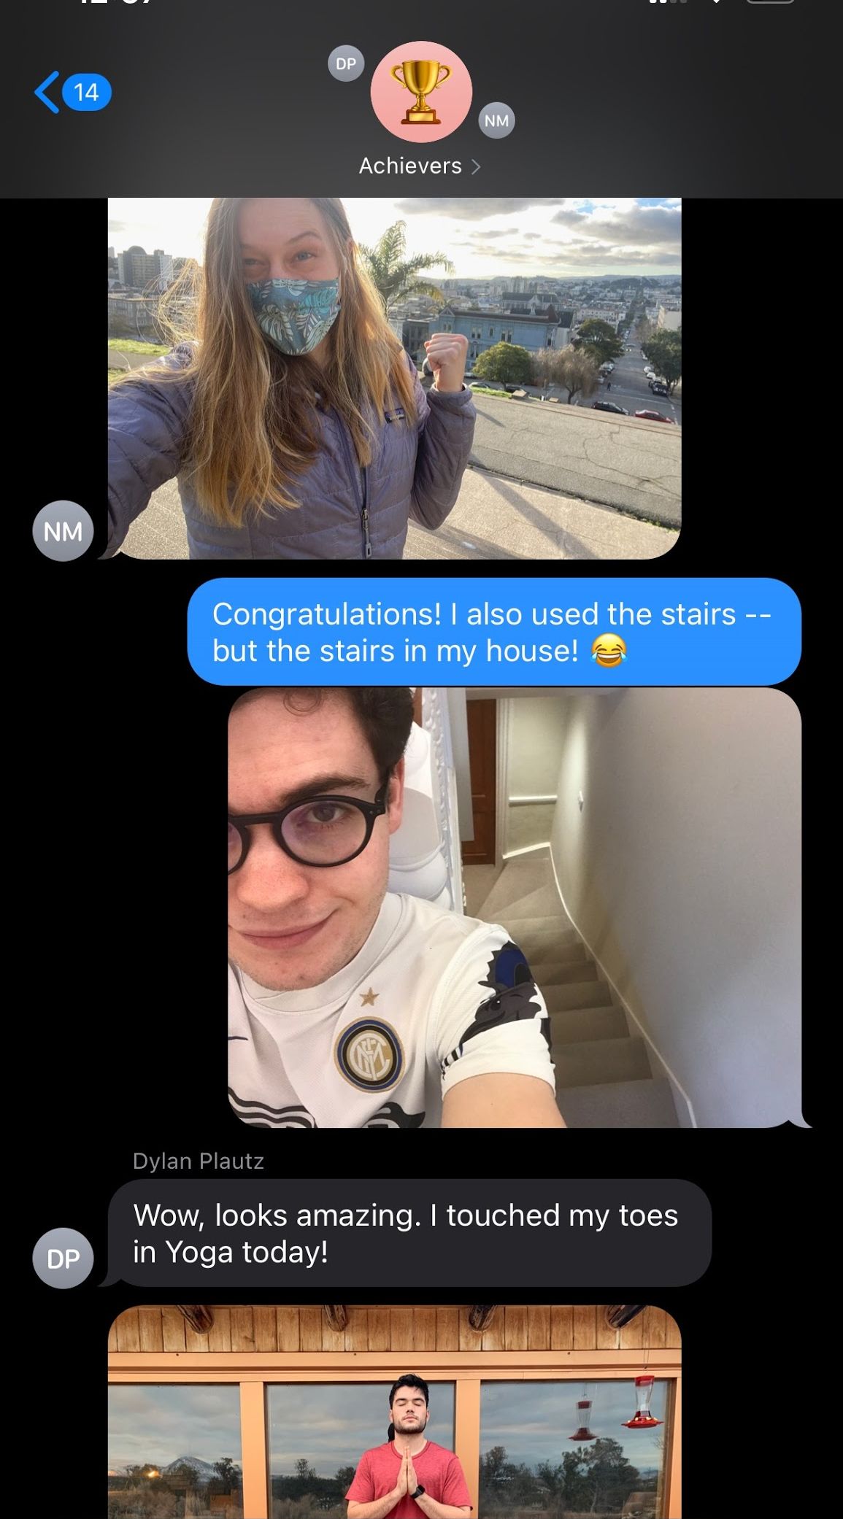
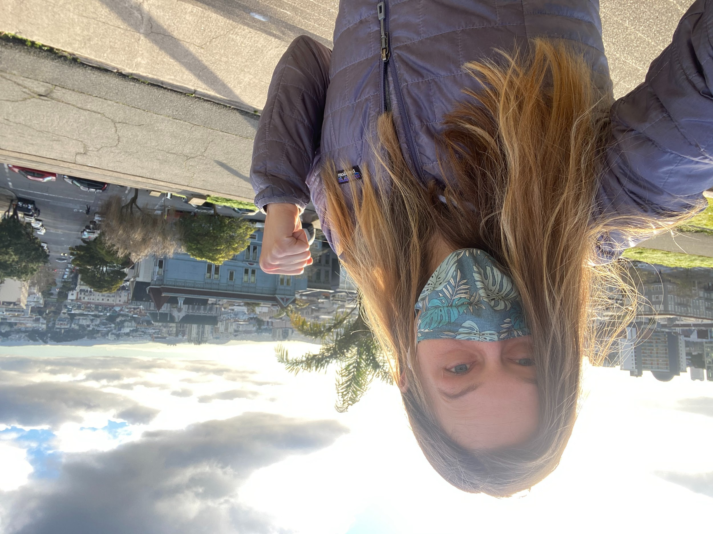
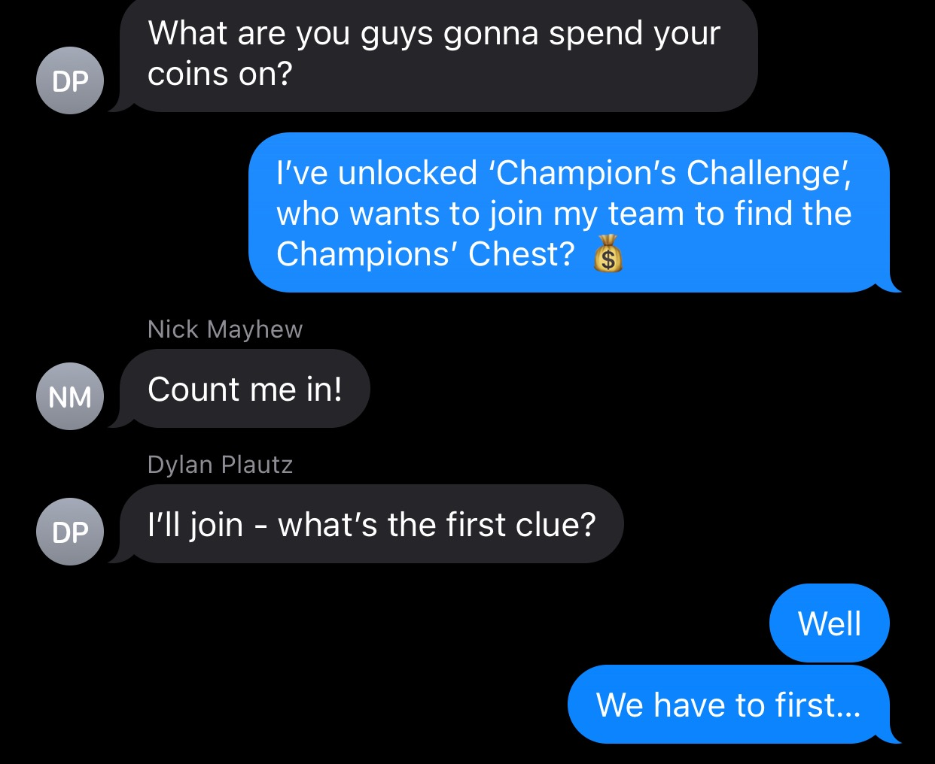
Tasks
Simple
Medium
Difficult
Achieve your first coin
Meet your community
Spend coins on a reward

Slide 6
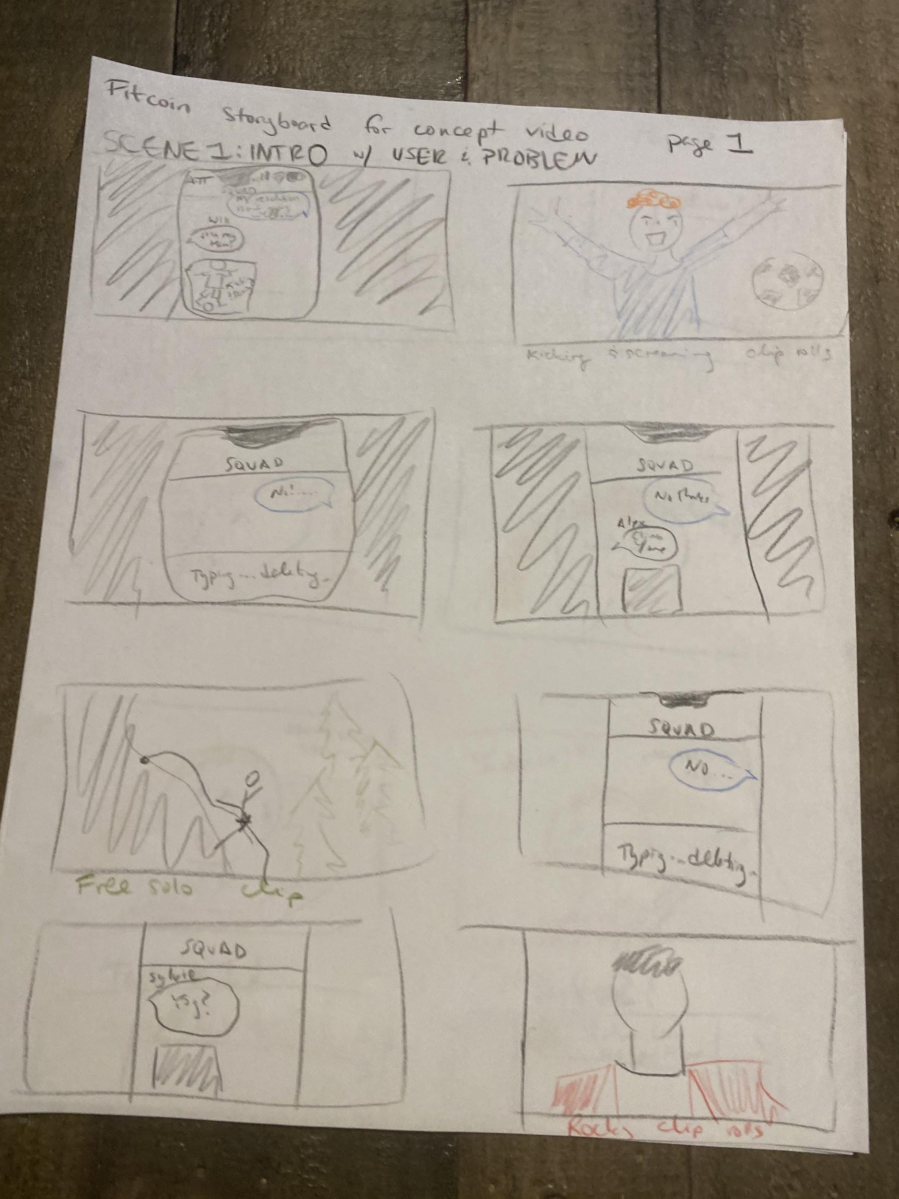
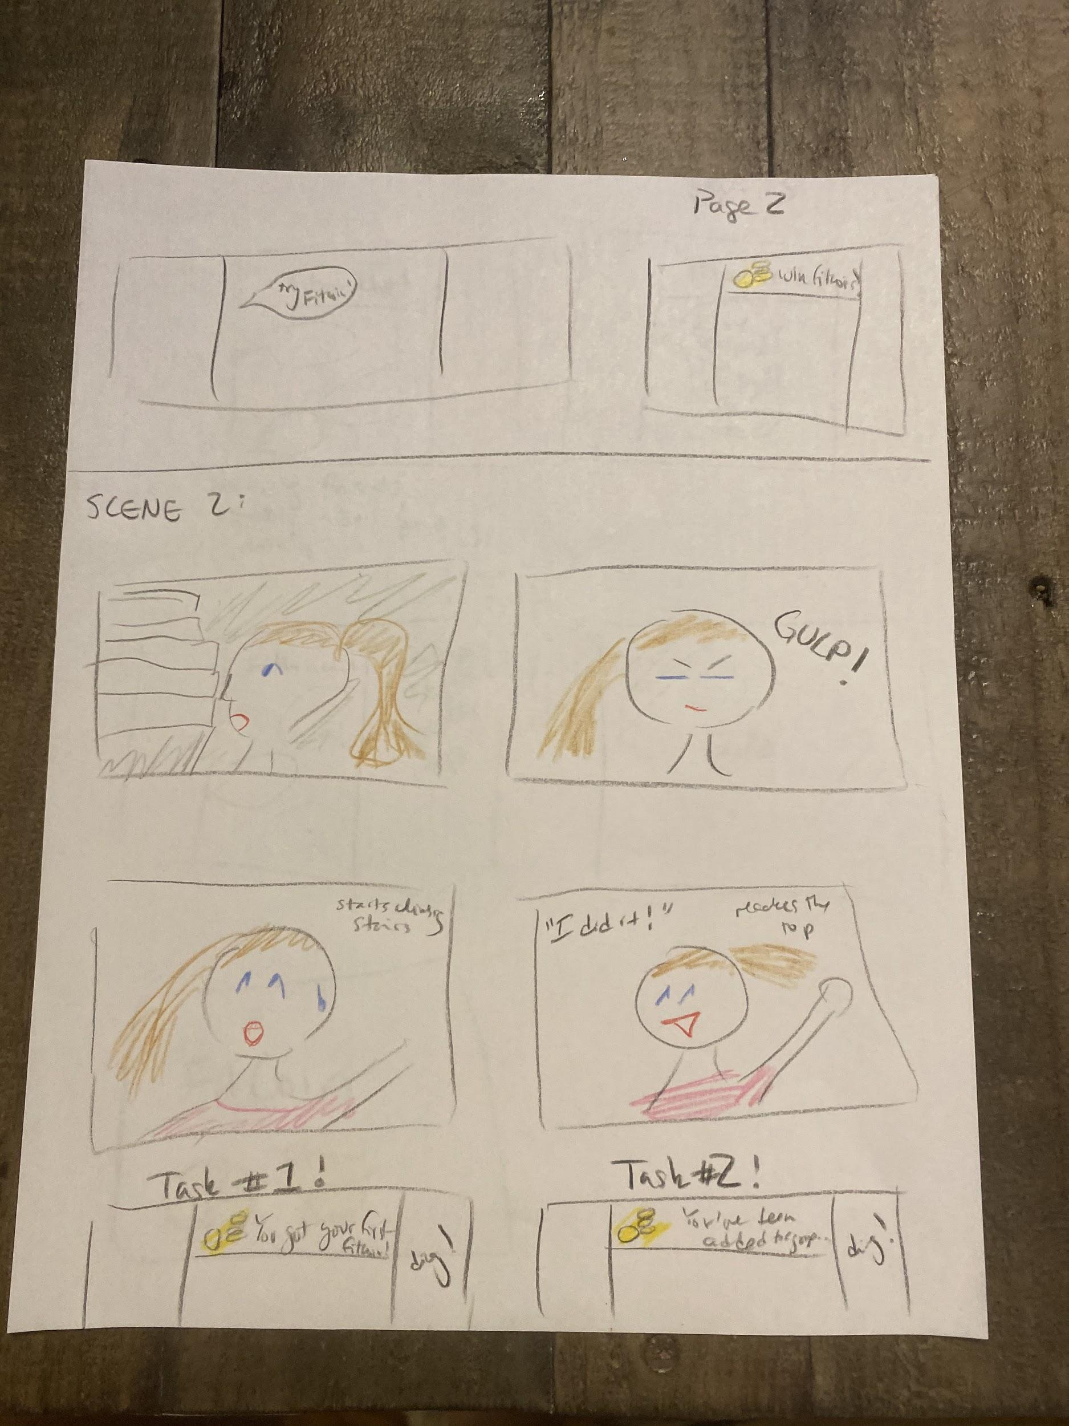
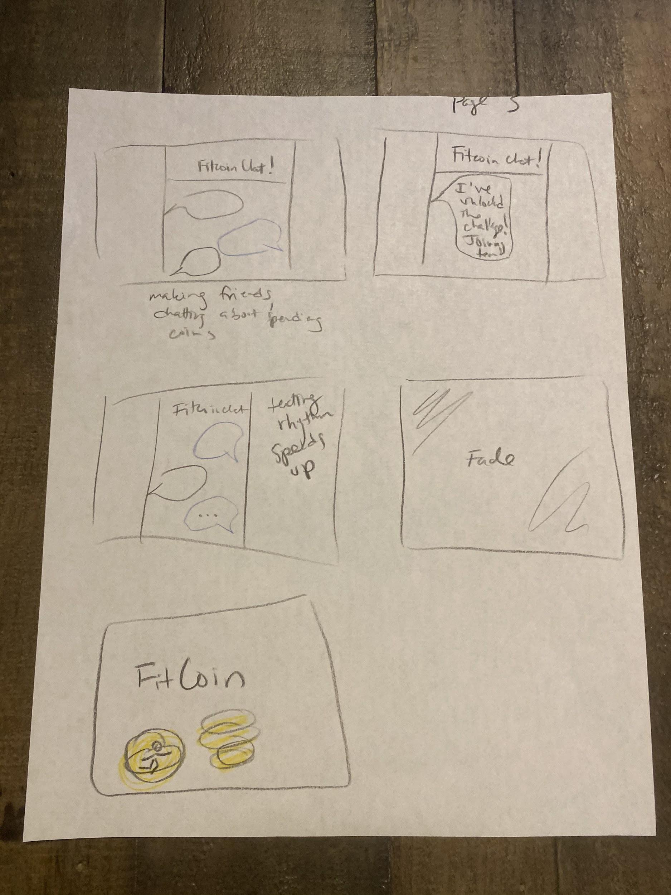
Storyboard

Slide 7

F I T C O I N
Notes:
https://youtu.be/F0loYK7LzyA

